Slide 2
From databases to API An efficient solution both on-premises and in Azure
Davide Mauri

Slide 3






















Telemetry/Logging
Frontends
Realtime Updates
Mobile Apps
Web App
Admin Portal
Realtime alerts and updates via SignalR
Application Insights
API layer
Azure AD
GraphQL API
GraphQL API
Modern Cloud Arch.
REST API
Distributed Cache
REST API
Containers
Functions
Vehicle Position Notifier
Data API builder
Azure Key Vaults
Services
Analytics
Database
Events
Trip Status Updates Function App
Vehicle Positions Function App
ML endpoints
Power BI
Trip Status Updates Event Hubs
Vehicle Positions Event Hub
Azure SQL
Database
Machine Learning
Synapse

Slide 4
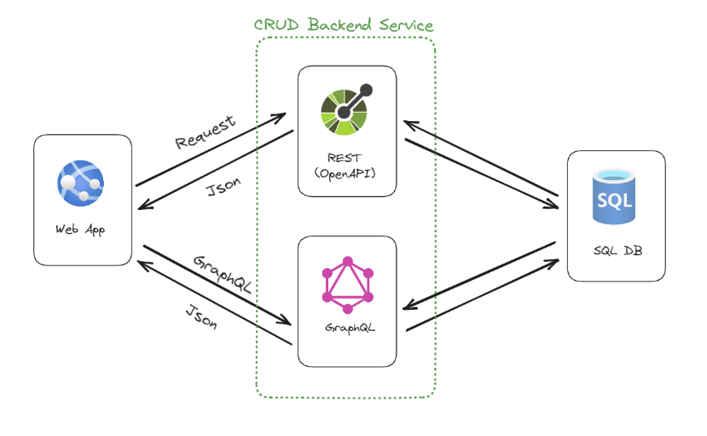
Jamstack / Fullstack

Slide 5

Data API builder
https://aka.ms/dab
Instantly provides REST and GraphQL endpoints for
Tables
Views
Stored Procedures
With full support for
Pagination
Sorting
Filtering
Selection
(GraphQL Only) Relationships

Slide 6
Data API builder
What about security?
Authentication via OAuth2 (AAD & EasyAuth: GitHub, Twitter, etc..)
Authorization via defined policies
Policies can access OAuth2 claims data
What about deployment?
Open Source, works on-prem without any limitation
Distributed as NuGet package and Containerized Image
Integrated with Static Web Apps

Slide 7
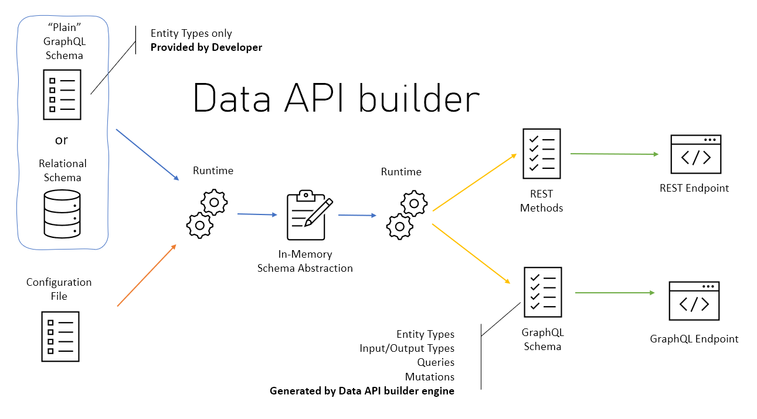

Slide 8
Getting Started with Data API builder
Install Data API Builder (DAB)
Initialize the configuration file
Add an entity
Run DAB, done!
dotnet tool install Microsoft.DataApiBuilder -g
dab init --database-type mssql --connection-string "@env('MSSQL')"
dab add Session --source "dbo.sessions" --permissions "anonymous:*"
dab start

Slide 9
DEMO

Slide 10
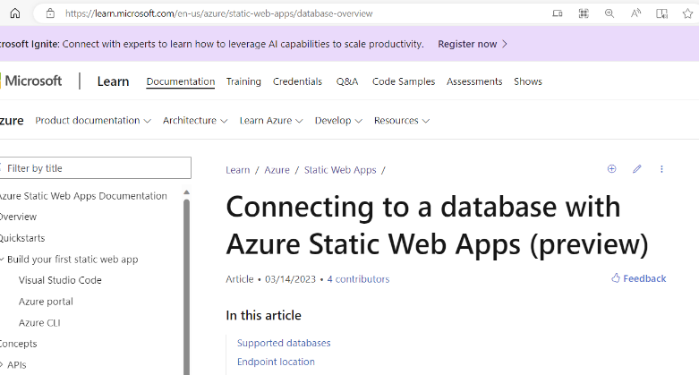
Integration with Static Web Apps
Static Web Apps is a great service to build Fullstack Applications
https://learn.microsoft.com/en-us/azure/static-web-apps/database-overview

Slide 11
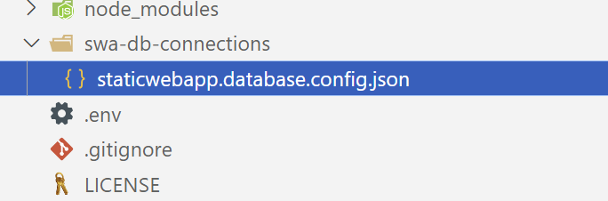
Integration with Static Web Apps
Heavily integrated with SWA CLI for a great offline development experience
To initialize the file use SWA CLI instead of DAB CLI
swa db init --database-type mssql --connection-string "@env('MSSQL')"

Slide 12
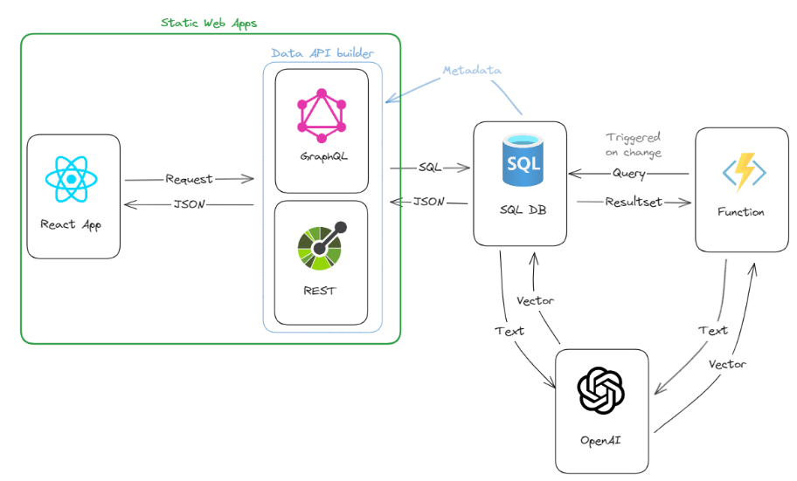
End-2-End Sample
https://sessionfinder.dotnetconf.net/
https://github.com/Azure-Samples/azure-sql-db-session-recommender

Slide 13

Resources
Download .NET 8 aka.ms/get-dotnet-8
Data API builder https://aka.ms/dab
Session Recommender Sample https://github.com/Azure-Samples/azure-sql-db-session-recommender
Azure SQL Free Tier https://aka.ms/freedb

Slide 14
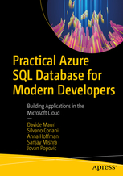
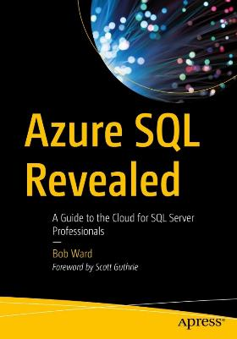
Resources
The Awesome Azure SQL list
https://aka.ms/awesome-sql
An updated list of everything that can help you to get the best out of Azure SQL DB
Samples and Best Practices
https://github.com/yorek/azure-sql-db-samples
Data API builder
Source Code: https://aka.ms/dab
Documentation: https://learn.microsoft.com/en-us/azure/data-api-builder/
Practical Azure SQL Database for Modern Developers Book
https://github.com/yorek/practical-azure-sql-db-for-modern-developers
https://github.com/microsoft/bobsql/tree/master/azuresqlbook

Slide 15
Download DAB
https://aka.ms/dab

Slide 16
Download .NET 8
https://aka.ms/get-dotnet-8

